Slide 1

HEALTHCARE aNALYTIC & MEDICAL COST PREDICTION SYSTEM…..
Performance Report
Real-time patient insights with predictive modeling to estimate healthcare costs..
Prepared by :
Name : Vishal Panchal
Data Scientist
Panchal Multispeciality Hospital

Slide 2
Project Overview
Problem Statement:
Predicting medical costs accurately based on patient health, lifestyle, and insurance factors.
Project Goal:
To provide cost estimation, analyze insurance impact, and generate meaningful patient insights using data analytics and machine learning.

Slide 3
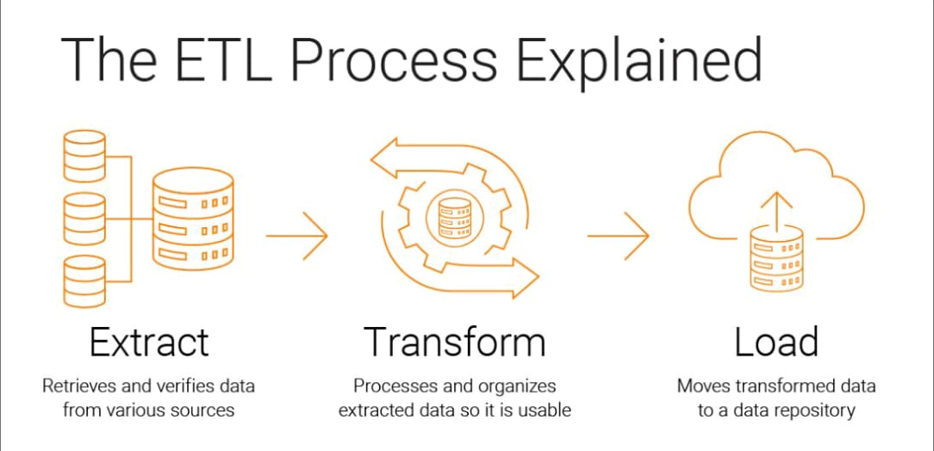
ETL PROCESS
Extract → Data is collected from multiple sources such as CSV, XML, JSON, Excel, and SQL databases.
Transform → Data is cleaned and processed by handling missing values, removing duplicates, formatting data, and applying value mapping.
Load → The final cleaned and transformed data is stored in a SQL database for analysis and reporting.

Slide 4
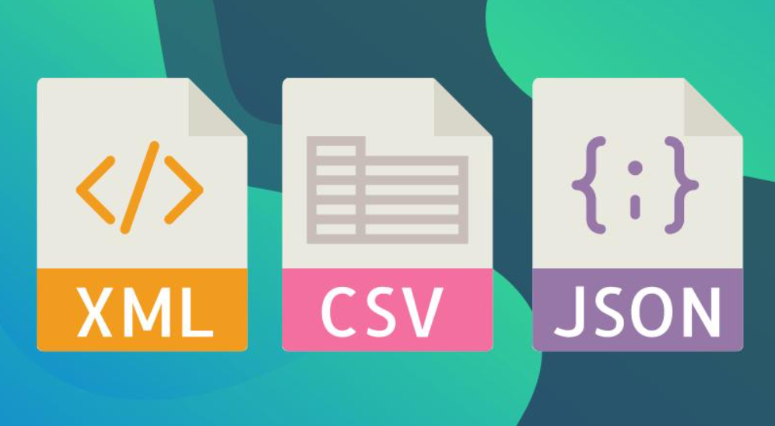
Data Sources
These are the different data sources used in the project, including CSV, XML, JSON, Excel, and SQL databases."
Extract -
CSV (Hospital Visits, Lab Tests)
XML (Hospital, Patient Data)
Excel (Lifestyle Data)
JSON (Medical Billing, History)
SQL (Insurance Data)
TEXT (Prescription)

Slide 5
Transform - Data Cleaning Steps
Select Values → Selects required columns and removes unnecessary fields.
Replace in String → Replaces incorrect or unwanted characters in text data.
String Operations → Standardizes text using functions like UPPER, LOWER, and TRIM.
Value Mapper → Converts categorical values into a consistent format.
Handle NULL Values → Replaces or manages missing data appropriately.
Remove Duplicates → Eliminates duplicate records to ensure data uniqueness.
Sorting → Arranges data in a structured and meaningful order.

Slide 6
Data Loading
Cleaned data is loaded into a SQL database and structured into multiple tables for analysis and reporting
The cleaned and transformed data is loaded into a SQL database.
Data is organized into multiple structured tables such as Patient, Hospital, Billing, and others.

Slide 7
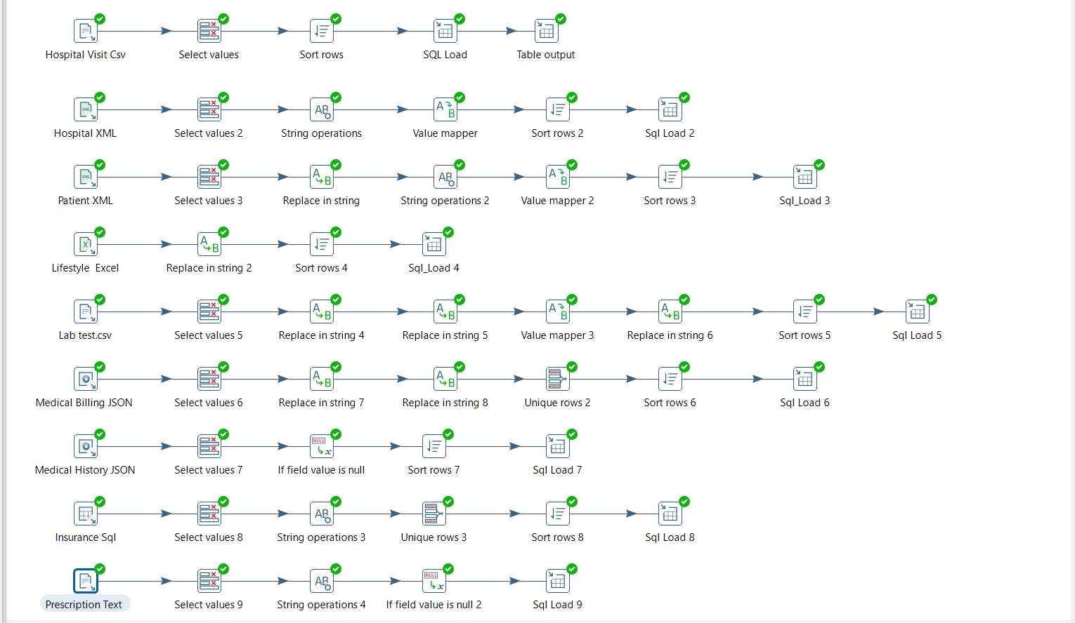
This diagram represents the ETL transformation workflow implemented using Pentaho, where data is cleaned, processed, and loaded into the database.

Slide 8
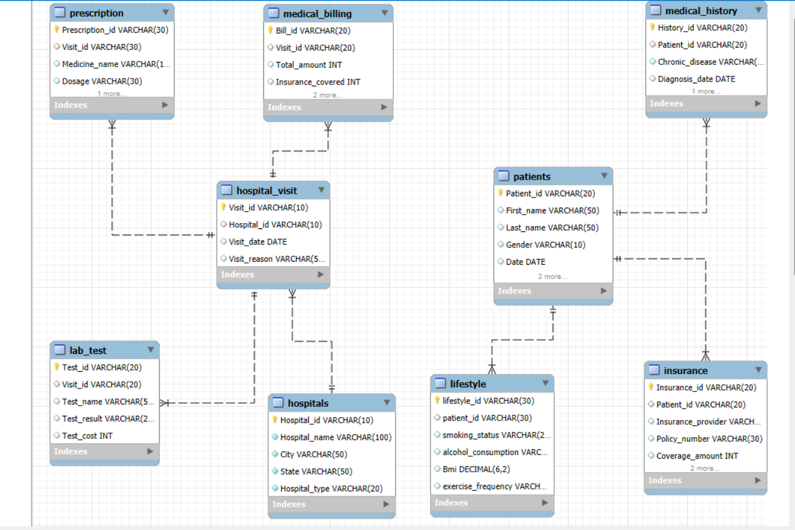
This ER diagram shows how different entities in the database are related using primary and foreign keys.
1) Defines the overall database design and organization.
2) Visualizes how different entities are interconnected
3) Covers major entities such as Patient, Hospital, Billing, and Insurance
4) Maintains relationships through primary and foreign key constraints

Slide 9
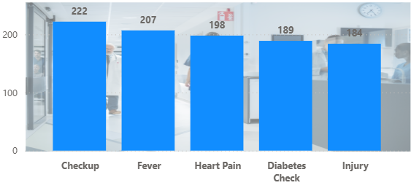
Count of Patient by Visit Reason
Shows the number of patients based on different visit reasons .
Helps identify the most common medical concerns (Checkup, Fever, Heart Pain, Diabetes , Injury)

Slide 10
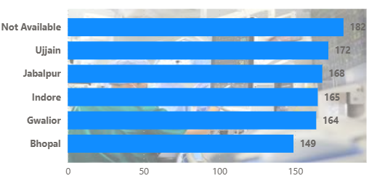
Count of Allergies by City ….
Heading: City – Wise Allergies Patient Count .
Chart :
Displays the number of allergy cases across different cities
Helps identify cities with higher prevalence of allergies.
Supports location-based healthcare analysis and decision-making

Slide 11
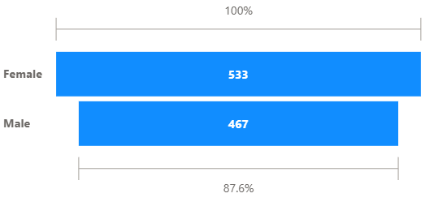
This chart shows the gender-wise distribution of patients, helping in understanding demographic patterns.
Displays the distribution of patients based on gender (Male and Female)
Helps compare the number of male and female patients
Provides insights into gender-wise patient demographics

Slide 12
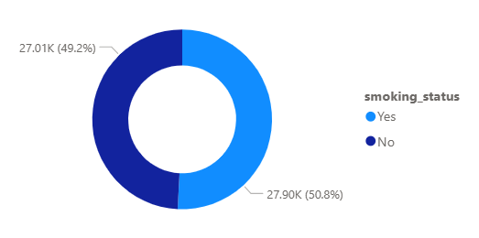
The distribution is almost balanced, indicating comparable proportions of smokers and non-smokers in the dataset.
Represents the proportion of patients based on smoking status (Yes/No)
Provides a clear comparison between smokers and non-smokers
Helps in analyzing lifestyle factors affecting patient health

Slide 13
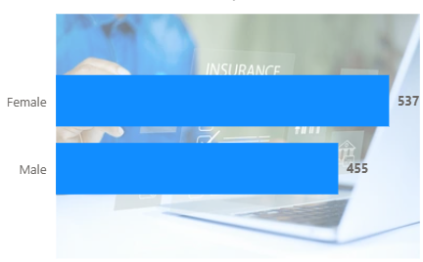
Displays the distribution of insured patients across gender categories
This chart highlights gender-wise insurance coverage, showing that female patients have slightly higher insurance coverage compared to male patients
Compares insurance coverage between male and female patients
Helps identify gender-based differences in insurance utilization

Slide 14
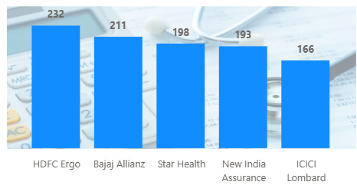
Compares patient distribution across insurance providers to identify the most utilized insurance services.
i) Shows how patients are distributed across different insurance providers
ii) Highlights the most preferred insurance companies among patients
iii) Helps analyze provider-wise coverage and market preference trends

Slide 15
Dataset for Machine Learning
Dataset is derived from the ETL pipeline after data extraction, transformation, and loading.
Cleaned and structured data is used for model building.
Includes key features such as Age, BMI, Insurance, and Test Cost

Slide 16
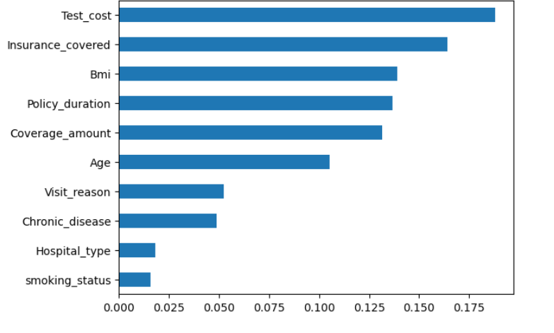
This chart shows that cost-related and insurance-related features have the highest impact on the model, while variables like smoking status and hospital type contribute less.
Identifies the most relevant independent variables influencing the target variable.
Highlights key features such as Test Cost, Insurance Covered, and BMI with higher impact.
Helps in improving model accuracy by focusing on significant predictors

Slide 17
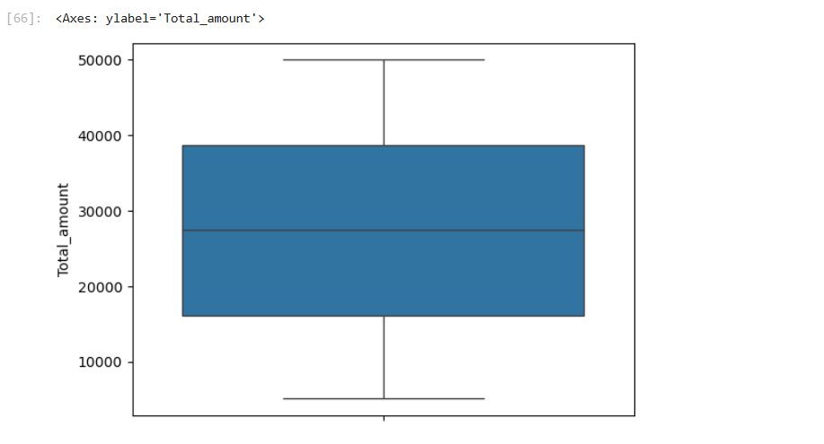
Analyzes the distribution and variability of the target variable to detect outliers and data spread.
Visualizes the distribution of the target variable (Total Amount).
Shows median, quartiles, and overall data spread.
Helps identify outliers and variability in medical costs
Outliers indicate extreme medical expenses which may affect model performance.

Slide 18
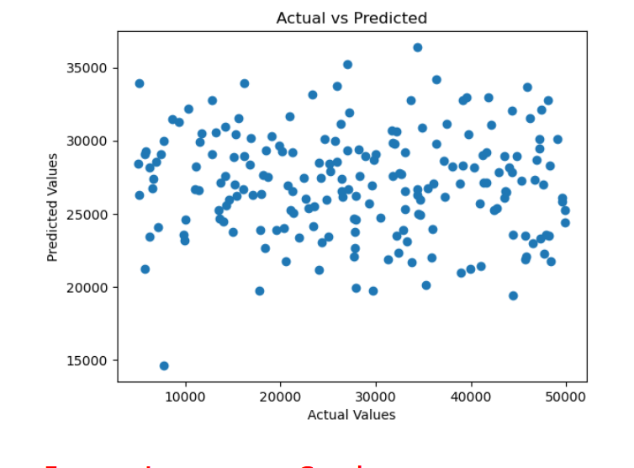
Evaluates model accuracy by comparing actual and predicted values.
Model Performance: Actual vs Predicted Analysis
Compares actual values with model-predicted values to evaluate performance.
Shows how closely the predictions align with real data points.
Helps assess the accuracy and reliability of the machine learning model.

Slide 19
Evaluates model accuracy and prediction performance.
Model performance evaluated using prediction results
MAE indicates the average prediction error in medical cost
The model shows acceptable performance with scope for further improvement

Slide 20
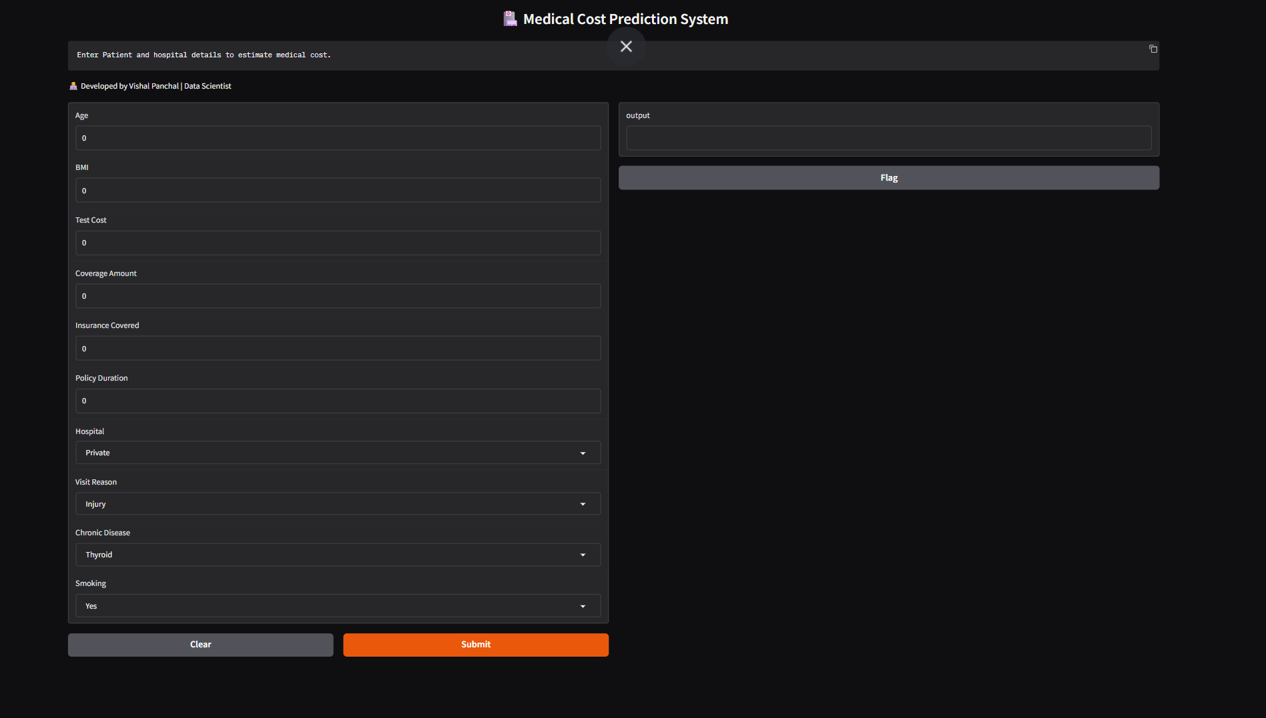
Medical Cost Prediction System
User inputs patient details (Age, BMI, Insurance, etc.)
Model predicts medical cost in real-time.
This makes the system user-friendly and applicable in real-world healthcare scenarios.

Slide 21

Recommendations
Recommendations:-
Improve model accuracy using advanced algorithms Random Forest.
2 . Perform feature engineering to enhance prediction quality.
3 . Increase dataset size to improve model performance and reliability.
4. Incorporate additional features such as patient medical history and lifestyle factors
5. Deploy the model as a web application for real-world use

Slide 22
Thank You
We appreciate your time and attention .
For any question or suggestion , feel fre to reach out .

